Slide 1
LENDING CLUB ASSIGNMENT SUBMISSION
Name: Hitesh Gupta
Parth Trivedi

Slide 2
Executive summary
Objectives
Lending Club is an online facilitator for different types of loans and provides a platform to the Lenders and Borrowers to transact using this platform. It also provides with the initial data about the borrowers to the lenders so that the most appropriate interest rate and amount can be evaluated for the borrower.
Information provided
Data for the period 2007 – 2011 has been provided by Lending club for analysis the factors driving the default rate of the loans. The Data set includes key attributes such as – Inteerst rate, amount, term and status. It also provided demographical details about the borrower such as Location, Annual Income, employment year etc.
Expected output
It is expected that key factors impacting the default rates are identified and a set of recommendation is given for identifying the risk across each loan

Slide 3
Problem Solving Methodology
Data Preparation and Cleaning
Data Analysis
Visualization of the result
Load the Data from the loans.csv file to dataset for analysis.
Perform data cleaning steps to remove the Rows and Columns which have a lot of ‘NA’ records
Identify the data into categorical and continuous categories for analysis. Identify the target column.
Perform Univariate analysis on the key factors impacting the default rates for the loan.
Perform Bivariate analysis to identify the co-relation across different attributes and the impact of the target attribute.
Plot charts to visualize the attributes and identify the trends

Slide 4
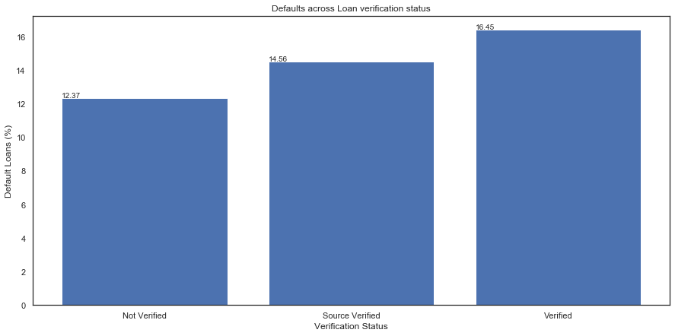
Key Recommendations
Default rates for Income verified by Lending Club
It is observed that the default rates for the transaction where the Income was verified by Lending Club is marginally higher than the non-verified transaction.

Slide 5
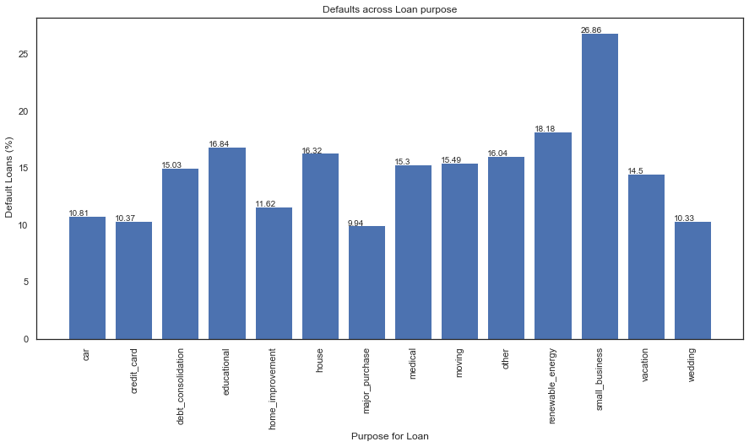
Key Recommendations
Purpose of the Loan impacting the default rates
It is observed that the default rates for the transaction where the loan has been applied for starting a small business is substantially higher when compared to other loans

Slide 6
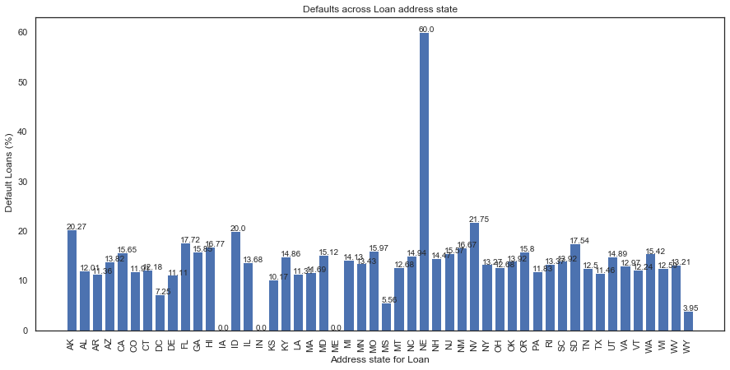
Key Recommendations
Location of the borrower impacting the default rates
It is observed that the default rates for the borrowers residing in ‘Nebraska’ NE is significantly higher than other States.

Slide 7
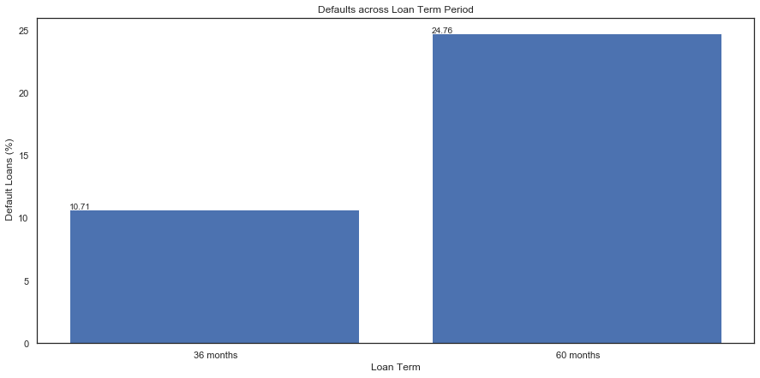
Key Recommendations
Loan Term impacting the default rates
Term of the Loan significantly impacts the default rate. Loans with longer term of 60 Months have a higher default rate as compared to shorter loans of 36 months.

Slide 8
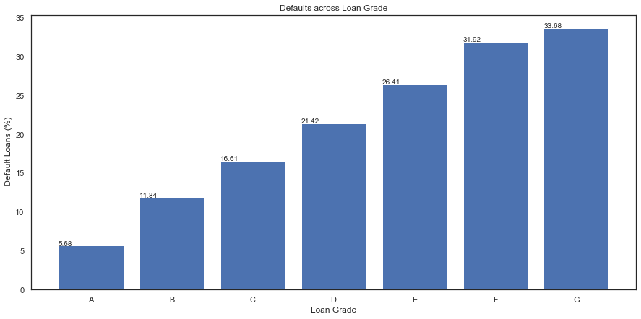
Key Recommendations
Loan Grades assigned by Lending Club has a co-relation with the Loan defaults
‘Grades’and ‘Sub-Grades’ assigned by Lending club has a co-relation with the default rates. Default rates is higher in the higher grades such as E,F and G.

Slide 9
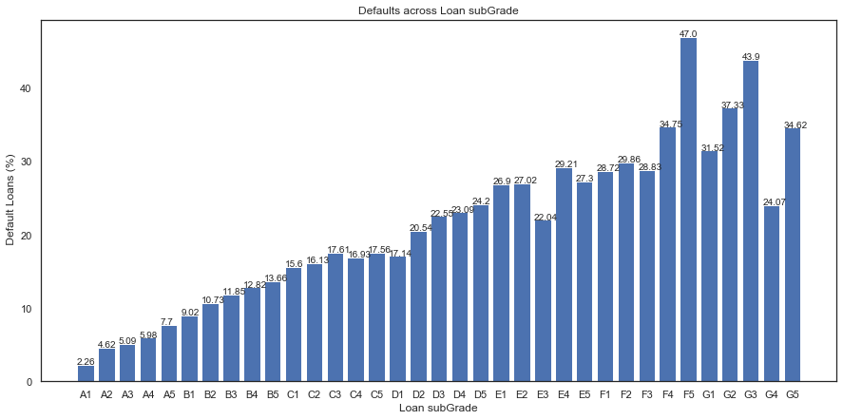
Key Recommendations
Loan Grades assigned by Lending Club has a co-relation with the Loan defaults
Sub-Grades such as F5 and G3 have a very high default rate.

Slide 10
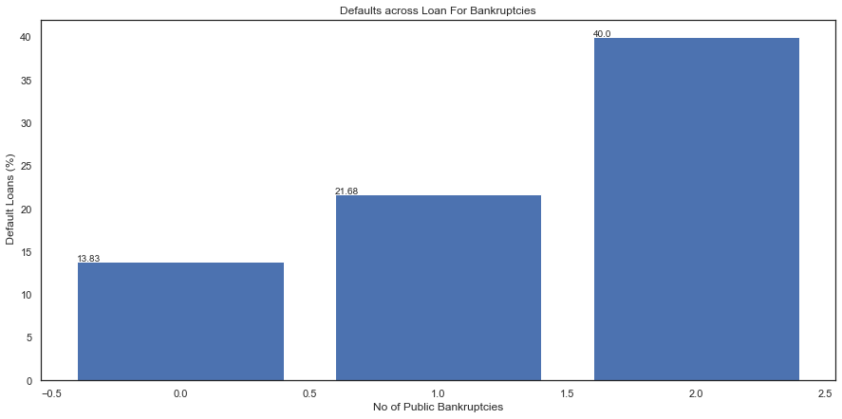
Key Recommendations
Borrowers with past record of Bankruptcies have higher default rates
Sub-Grades such as F5 and G3 have a very high default rate. Defaults are lowest for borrower with no bankruptcies.

Slide 11
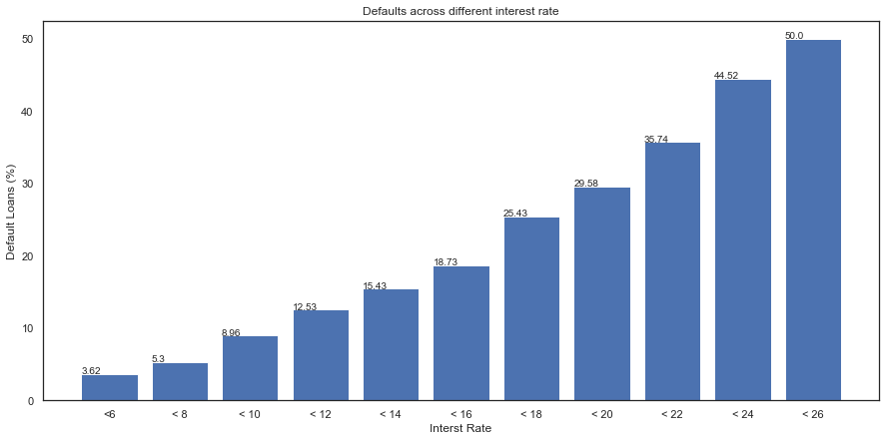
Key Recommendations
Loans with higher interest rates have a higher default rate.
Loan default rates increase proportionally with the interest rate. It is substantially higher for loans with interest rate above 22%

Slide 12
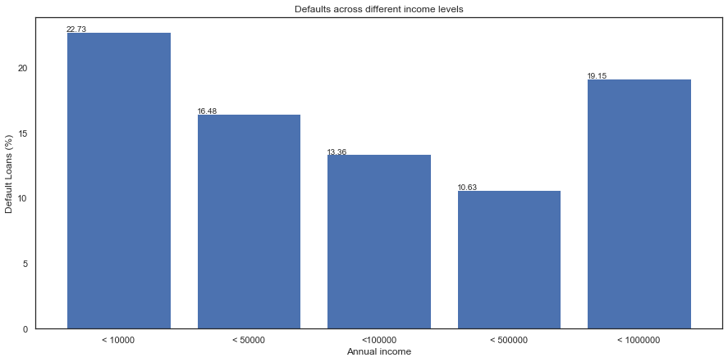
Key Recommendations
Borrowers in the lowest and highest income group have a higher default rate
Borrowers with annual income levels less than 10K and higher than 500K have significantly higher default rates.

Slide 13
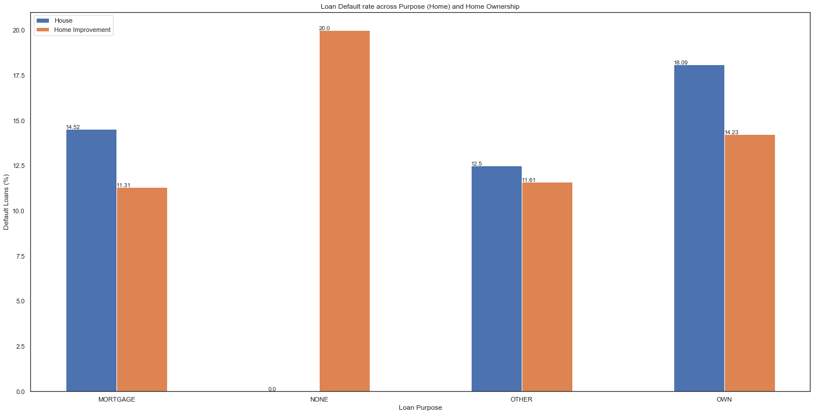
Key Recommendations
Some borrowers with the home ownership mentioned as ‘None’ also apply for loans for the purpose of home improvement. They have a higher default rate.

